Slide 1
UNIT III
Cloud computing Architecture and Management: Managing the cloud and managing the cloud infrastructure using AWS cloud Front, Managing the cloud application, Managing Identity and Access (IAM), Migrating Application to cloud, Phases of cloud migration, Approaches for Cloud Migration.

Slide 2
Introduction
As we know, cloud computing technology is used by both small and large organizations to store the information in cloud and access it from anywhere at anytime using the internet connection.
There are several processes and components of cloud computing that need to be discussed. One of the topics of such prime importance is architecture.
Architecture is the hierarchical view of components over which the existing technology is built and the components that are dependent on the technology.
Another topic that is related to architecture is anatomy. Anatomy describes the core structure of the cloud.

Slide 3
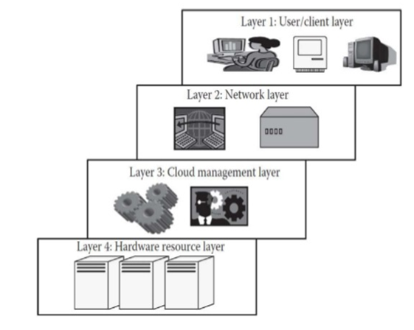
Cloud Architecture
Any technological model consists of an architecture based on which the model functions, and has a hierarchical view of describing the technology.
The cloud also has an architecture that describes its working mechanism. It includes the dependencies on which it works and the components that work over it.
The cloud is a recent technology that is completely dependent on the Internet for its functioning
Architecture can be divided into four layers based on the access of the cloud by the user. They are as follows.

Slide 4
Layer 1 (User/Client Layer)
This layer is the lowest layer in the cloud architecture, All the users or client belong to this layer.
This is the place where the client/user initiates the thick client, or thin client i.e,mobile or any handheld device that would support basic functionalities to access a web application.
The thin client here refers to a device that is completely dependent on some other system for its complete functionality. In simple terms, they have very low processing capability. Everyday examples of thin clients include Yahoo Messenger, Office 365, Microsoft Outlook.
Similarly, thick clients are general computers that have adequate processing capability. They have sufficient capability for independent work. Everyday examples of thick clients include desktop PCs or laptops running Windows or MacOS
Usually, a cloud application can be accessed in the same way as a web application. But internally, the properties of cloud applications are significantly different. Thus, this layer consists of client devices.

Slide 5
Layer 2 (Network Layer)
This layer allows the users to connect to the cloud.
The whole cloud infrastructure is dependent on this connection where the services are offered to the customers.
The public cloud usually exists in a specific location and the user would not know the location as it is abstract. And, the public cloud can be accessed all over the world. In the case of a private cloud, the connectivity may be provided by a local area network (LAN).
Even in this case, the cloud completely depends on the network that is used. Usually, when accessing the public or private cloud, the users require minimum bandwidth, which is sometimes defined by the cloud providers.
This layer does not come under the purview of service-level agreements (SLAs), that is, SLAs do not take into account the Internet connection between the user and cloud for quality of service (QoS).

Slide 6
Layer 3 (Cloud Management Layer)
This layer consists of software's that are used in managing the cloud. The software’s can be a cloud operating system (OS), a software that acts as an interface between the data center and the user, or a management software that allows managing resources.
These software usually allow
- Resource management like scheduling, provisioning
- Optimization like server consolidation, storage workload consolidation and
- Internal cloud governance.
This layer comes under the purview of SLAs and also called as infrastructure of cloud. that is, the operations taking place in this layer would affect the SLAs that are being decided upon between the users and the service providers.
Any delay in processing or any discrepancy in service provisioning may lead to an SLA violation. As per rules, any SLA violation would result in a penalty to be given by the service provider. These SLAs are for both private and public clouds Popular service providers are Amazon Web Services (AWS) and Microsoft Azure for public cloud. Similarly, OpenStack and Eucalyptus allow private cloud creation, deployment, and management.

Slide 7
Layer 4 (Hardware Resource Layer)
Layer 4 consists of provisions for actual hardware resources.
Usually, in the case of a public cloud, a data center is used in the back end. Similarly, in a private cloud, it can be a data center, which is a huge collection of hardware resources interconnected to each other that is present in a specific location or a high configuration system.
This layer comes under the purview of SLAs. This is the most important layer that governs the SLAs. This layer affects the SLAs most in the case of data centers.
Whenever a user accesses the cloud, it should be available to the users as quickly as possible and should be within the time that is defined by the SLAs. As mentioned, if there is any discrepancy in provisioning the resources or application, the service provider has to pay the penalty.
Hence, the data center consists of a high-speed network connection and a highly efficient algorithm to transfer the data from the data center to the manager. There can be a number of data centers for a cloud, and similarly, a number of clouds can share a data center.

Slide 8
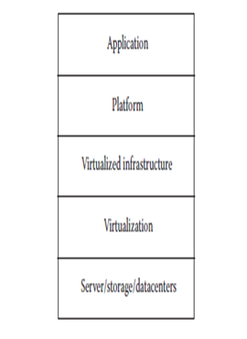
Anatomy of the Cloud
Cloud anatomy can be simply defined as the structure of the cloud. Cloud anatomy cannot be considered the same as cloud architecture. It may not include any dependency on which or over which the technology works , whereas architecture wholly defines and describes the technology over which it is working.
Architecture is a hierarchical structural view that defines the technology as well as the technology over which it is dependent or/and the technology that are dependent on it. Thus, anatomy can be considered as a part of architecture.

Slide 9
There are basically five components of the cloud:
1. Application: The upper layer is the application layer. In this layer, any applications are executed.
2. Platform: This component consists of platforms that are responsible for the execution of the
application. This platform is between the infrastructure and the application.
3. Infrastructure: The infrastructure consists of resources over which the other components work. This
provides computational capability to the user.
4. Virtualization: Virtualization is the process of making logical components of resources over the
existing physical resources. The logical components are isolated and independent, which form the
infrastructure.
5. Physical hardware: The physical hardware is provided by server and storage units.

Slide 10
Managing the Cloud
Cloud management is aimed at efficiently managing the cloud so as to maintain the QoS. It is one of the prime jobs to be considered. The whole cloud is dependent on the way it is managed. Cloud management can be divided into two parts:
1. Managing the infrastructure of the cloud
2. Managing the cloud application
(1) Managing the Cloud Infrastructure
The infrastructure of the cloud is considered to be the backbone of the cloud. Mainly the infrastructure consists of Resource management, load consolidation and Internal cloud governance.
This component is mainly responsible for the QoS factor. If the infrastructure is not properly managed, then the whole cloud can fail and QoS would be adversely affected. The core of cloud management is resource management.

Slide 11
(a) Resource management:
A cloud infrastructure is a very complex system that consists of a lot of resources. It involves several internal tasks such as resource scheduling, provisioning, and load balancing. These tasks are mainly managed by the cloud service provider’s such as the cloud OS that is responsible for providing services to the cloud and that internally controls the cloud.
Poor resource management may lead to several inefficiencies in terms of performance, functionality, and cost.
Performance is the most important aspect of the cloud, because everything in the cloud is dependent on the SLAs and the SLAs can be satisfied only if performance is good.
Functionality of the cloud should always be provided and considered,even if there is a small discrepancy in providing the functionality, the whole purpose of maintaining is futile. A partially functional cloud would not satisfy the SLAs.

Slide 12
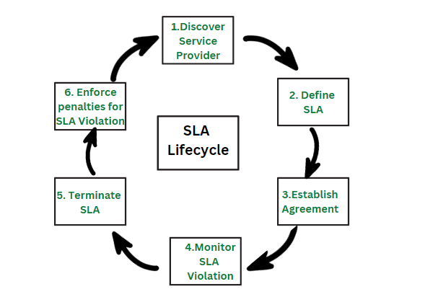
SLA’S

Slide 13
Cost is a very important criterion as far as the business prospects of the cloud are concerned . On the part of the service providers, if they incur less cost for managing the cloud, then they would try to reduce the cost so as to get a strong user base.
Hence, a lot of users would use the services, improving their profit margin. Similarly, if the cost of resource management is high, then definitely the cost of accessing the resources would be high and there is never a lossy business from any organization and so the service provider would not bear the cost and hence the users have to pay more.
Similarly, this would prove costly for service providers as they have a high chance of losing a wide user base, leading to only a marginal growth in the industry.
And, competing with its industry rivals would become a big issue. Hence, efficient management with less cost is required.

Slide 14
At a higher level, other than Performance , Functionality, cost issues, there are few more issues that depend on resource management.
These are power consumption and optimization of multiple objectives to further reduce the cost. To accomplish these tasks, there are several approaches followed, namely, Cloud optimization and consolidation of server and storage workloads.
Cloud optimization is the process of correctly selecting and assigning the right resources to a workload or application. That is process of eliminating cloud resource waste by selecting, provisioning, and right-sizing the resources you spend on specific cloud features.
Consolidation would reduce the energy consumption and in some cases would increase the performance of the cloud. According to Margaret Rouse [5], server consolidation by definition is an approach to the efficient usage of computer server resources in order to reduce the total number of servers or server locations that an organization requires.

Slide 15
(2) Load Balancing :
The previously discussed prospects are mostly suitable for IaaS. Each of the type has its own way of management. Load fluctuation is the point where the workload of the system changes continuously.
This is one of the important criteria and issues that should be considered for cloud applications.
Load fluctuation can be divided into two types: predictable and unpredictable.
- Predictable load fluctuations are easy to handle. The cloud can be preconfigured for handling
such kind of fluctuations.
- Unpredictable load fluctuations are difficult to handle, ironically this is one of the reasons why
cloud is preferred by several users.

Slide 16
(3) Cloud governance :
It is another topic that is closely related to cloud management.
Cloud governance is different from cloud management. Governance in general is a term in the corporate world that generally involves the process of creating value to an organization by creating strategic objectives that will lead to the growth of the company and would maintain a certain level of control over the company. Similar to that, here cloud organization is involved.
There are several aspects of cloud governance out of which SLAs are one of the important aspects.
SLAs are the set of rules that are defined between the user and cloud service provider that decide upon the QoS factor. If SLAs are not followed, then the defaulter has to pay the penalty.
The whole cloud is governed by keeping these SLAs in mind

Slide 17
(2) Managing the Cloud Application
Business companies are increasingly looking to move or build their corporate applications on cloud platforms to improve agility or to meet dynamic requirements that exist in the globalization of businesses and responsiveness to market demands.
But, this shift or moving the applications to the cloud environment brings new complexities.
Applications become more composite and complex, which requires leveraging not only capabilities like storage and database offered by the cloud providers but also third-party SaaS capabilities like e-mail and messaging.
So, understanding the availability of an application requires inspecting the infrastructure, the services it consumes, and the upkeep of the application.
The composite nature of cloud applications requires visibility into all the services to determine the overall availability and uptime.

Slide 18
Cloud application management is to address these issues and propose solutions to make it possible to have insight into the application that runs in the cloud as well as governance and auditing the environment management while the application is deployed in the cloud.
These cloud-based monitoring and management services can collect a multitude of events, analyze them, and identify critical information that requires additional remedial actions like adjusting capacity or provisioning new services.
Additionally application management has to be supported with tools and processes required for managing other environments that might coexist, enabling efficient operations.

Slide 19
Cloud Front

Slide 20
What is Amazon CloudFront?
Amazon CloudFront is a CDN service that speeds up distribution of your static and dynamic web content, such as .html, .css, .js, and image files, to your users
CloudFront delivers your content through a worldwide network of data centers called edge locations
When a user requests content that you're serving with CloudFront, the request is routed to the edge location that provides the lowest latency (time delay), so that content is delivered with the best possible performance

Slide 21
Content Delivery Network
A content delivery network (CDN) is a network of interconnected servers that speeds up webpage loading for data-heavy applications
When a user visits a website, data from that website's server has to travel across the internet to reach the user's computer
If the user is located far from that server, it will take a long time to load a large file, such as a video or website image
Instead, the website content is stored on CDN servers geographically closer to the users and reaches their computers much faster.

Slide 22
Why is CDN important?
The primary purpose of a content delivery network (CDN) is to reduce latency, or reduce the delay in communication created by a network's design
Because of the global and complex nature of the internet, communication traffic between websites (servers) and their users (clients) has to move over large physical distances
The communication is also two-way, with requests going from the client to the server and responses coming back.

Slide 23
Why is CDN important? (contd.)
A CDN improves efficiency by introducing intermediary servers between the client and the website server
These CDN servers manage some of the client-server communications
They decrease web traffic to the web server, reduce bandwidth consumption, and improve the user experience of your applications

Slide 24
Benefits of CDN
Reduce page load time
Reduce bandwidth costs
Increase content availability
Improve website security

Slide 25
What is Cloud front (contd.)?
If the content is already in the edge location with the lowest latency, CloudFront delivers it immediately.
If the content is not in that edge location, CloudFront retrieves it from an origin that you've defined—such as an Amazon S3 bucket etc.
For e. g., you might serve an image, sunsetphoto.png, using the URL https://example.com/sunsetphoto.png
CloudFront speeds up the distribution of your content by routing each user request through the AWS backbone network to the edge location that can best serve your content
You also get increased reliability and availability because copies of your files (also known as objects) are now held (or cached) in multiple edge locations around the world

Slide 26
Cloud Front Use Cases
Accelerate static website content delivery - CloudFront can speed up the delivery of your static content (for example, images, style sheets, JavaScript, and so on) to viewers across the globe
Serve video on demand or live streaming video - CloudFront can stream your media to global viewers—both pre-recorded files and live events
Encrypt specific fields throughout system processing - you can have additional level of security (using field level encryption) in addition to HTTPS security
Customize at the edge – error messages can be customized e. g. when server is down
Serve private content by using Lambda@Edge customizations – allows various customizations and server your content privately

Slide 27
How Cloud Front delivers content?
After you configure CloudFront to deliver your content, here’s what happens when users request your objects
A user accesses your website or application
DNS routes the request to the CloudFront POP (edge location) that can best serve the request
If the object is in the cache, CloudFront returns it to the user. If not available in the cache, CloudFront takes following steps –
CloudFront forwards the request to your origin server for the corresponding object—for example, to your Amazon S3 bucket or your HTTP server
The origin server sends the object back to the edge location
As soon as the data starts arriving, CloudFront begins to forward the object to the user
CloudFront also adds the object to the cache

Slide 28
Demo of CloudFront
CloudFront Distribution demo steps
Create Bucket with Website Enabled
Upload the sample files
Test Website is working
Create CloudFront Distribution for the buckets
Test the distribution
Disable and Delete the Distribution

Slide 29
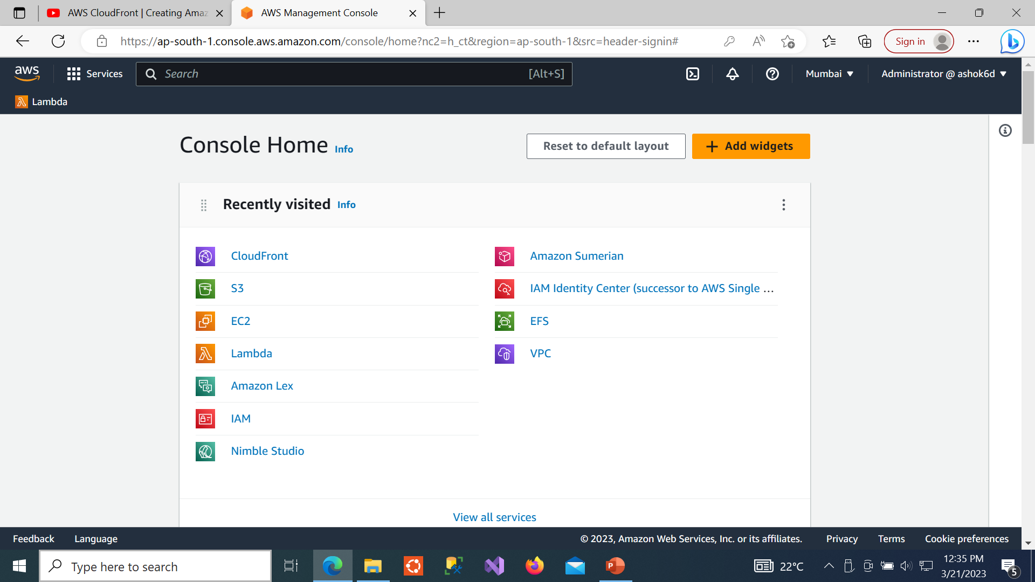
Create S3 Bucket with Static Website Enabled

Slide 30
S3 bucket
Create S3 Bucket
Give Bucket Name
ACL should be disabled
Uncheck Block all public access
Check the box for I acknowledge that the current settings ….
Create Bucket
Amazon S3 → Buckets → bucket name (give your bucket name here)
Choose Properties → Edit Static website hosting
Enable static website hosting
Enter index.html for Name of Index Document
Save Changes

Slide 31
S3 Bucket (contd.)
Upload the Files index.html
Copy the URL
Test the URL
Notes:
Note: replace bucket name with the name you have entered in Step 13

Slide 32
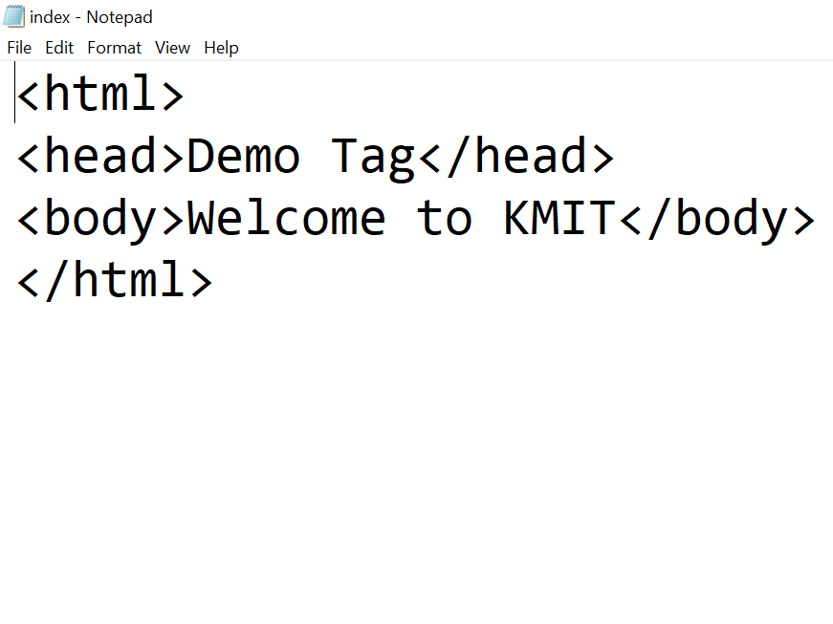
index.html file
Files uploaded to S3

Slide 33
Speed up website with Cloud Front

Slide 34
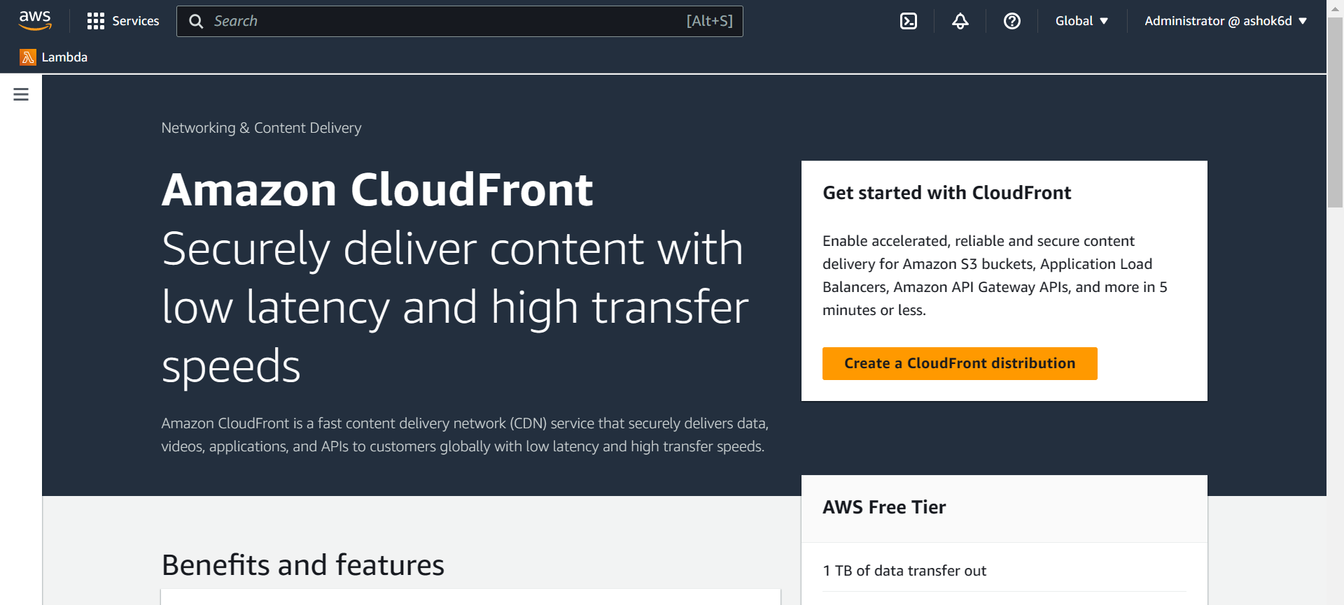
Create Cloud Front

Slide 35
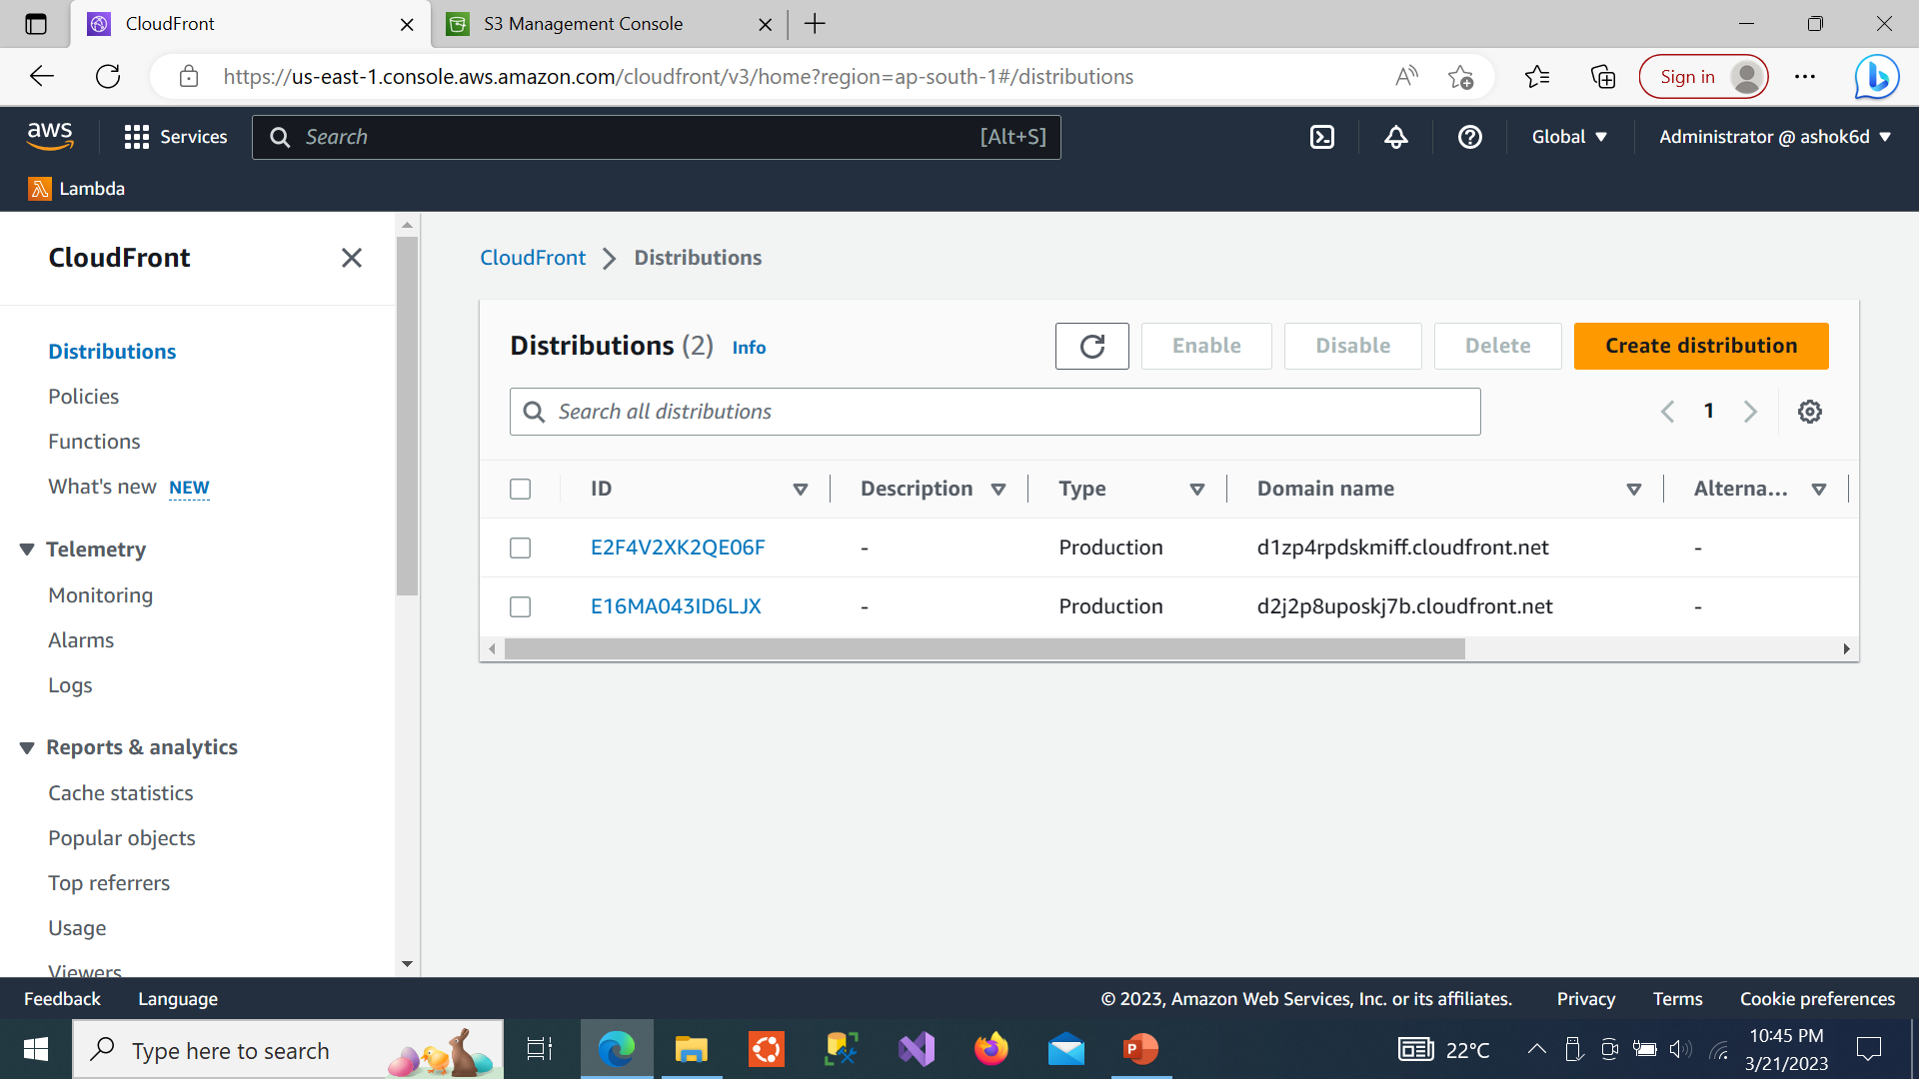
Create CloudFront Distribution

Slide 36
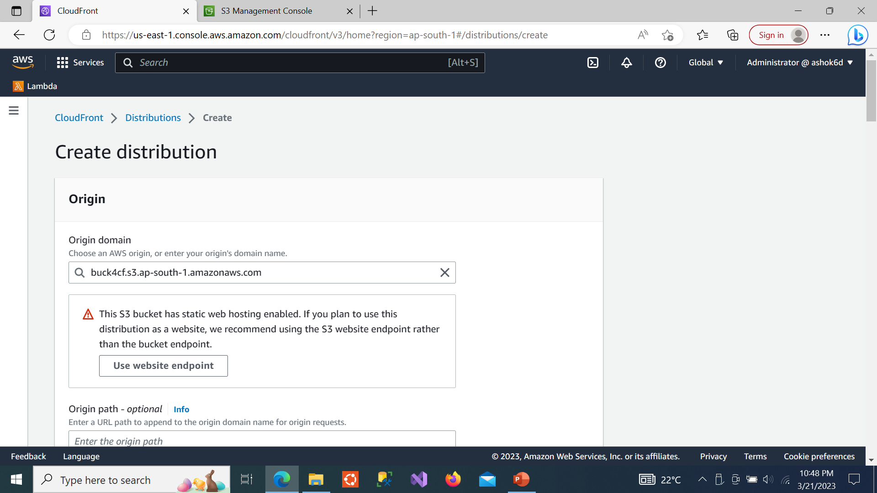
Enter Bucket Name
Notes:
Note: Use Web Site Endpoint otherwise it will give error later

Slide 37
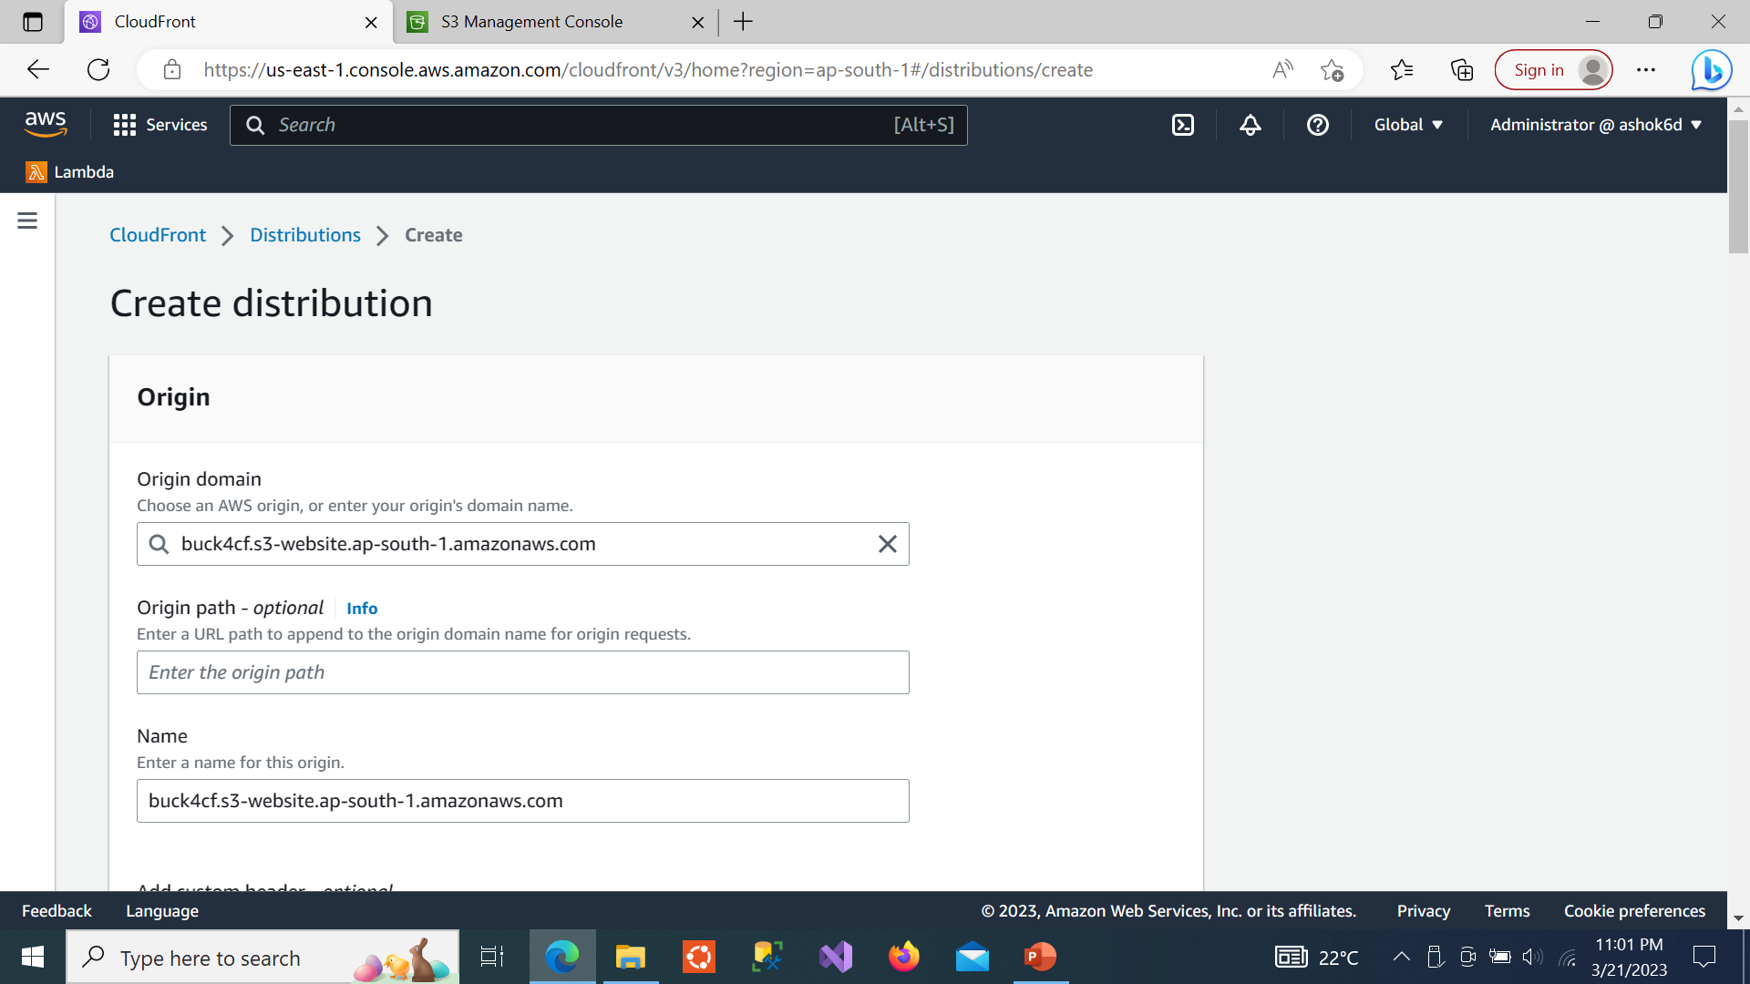
Check Endpoint is a Website

Slide 38
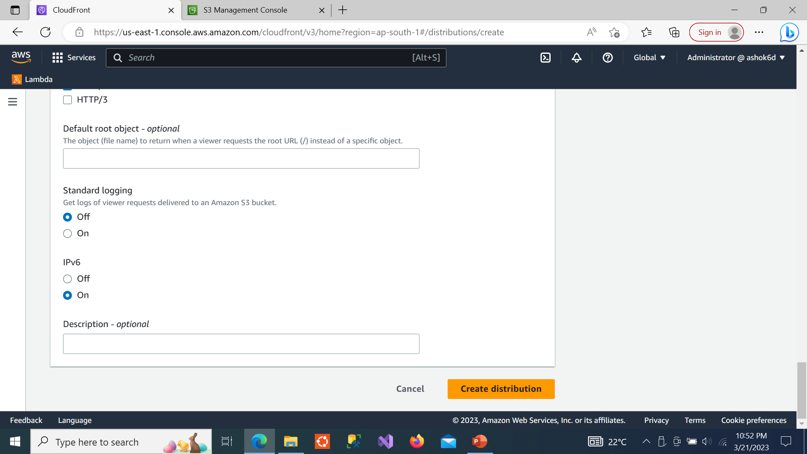
Create Distribution

Slide 39
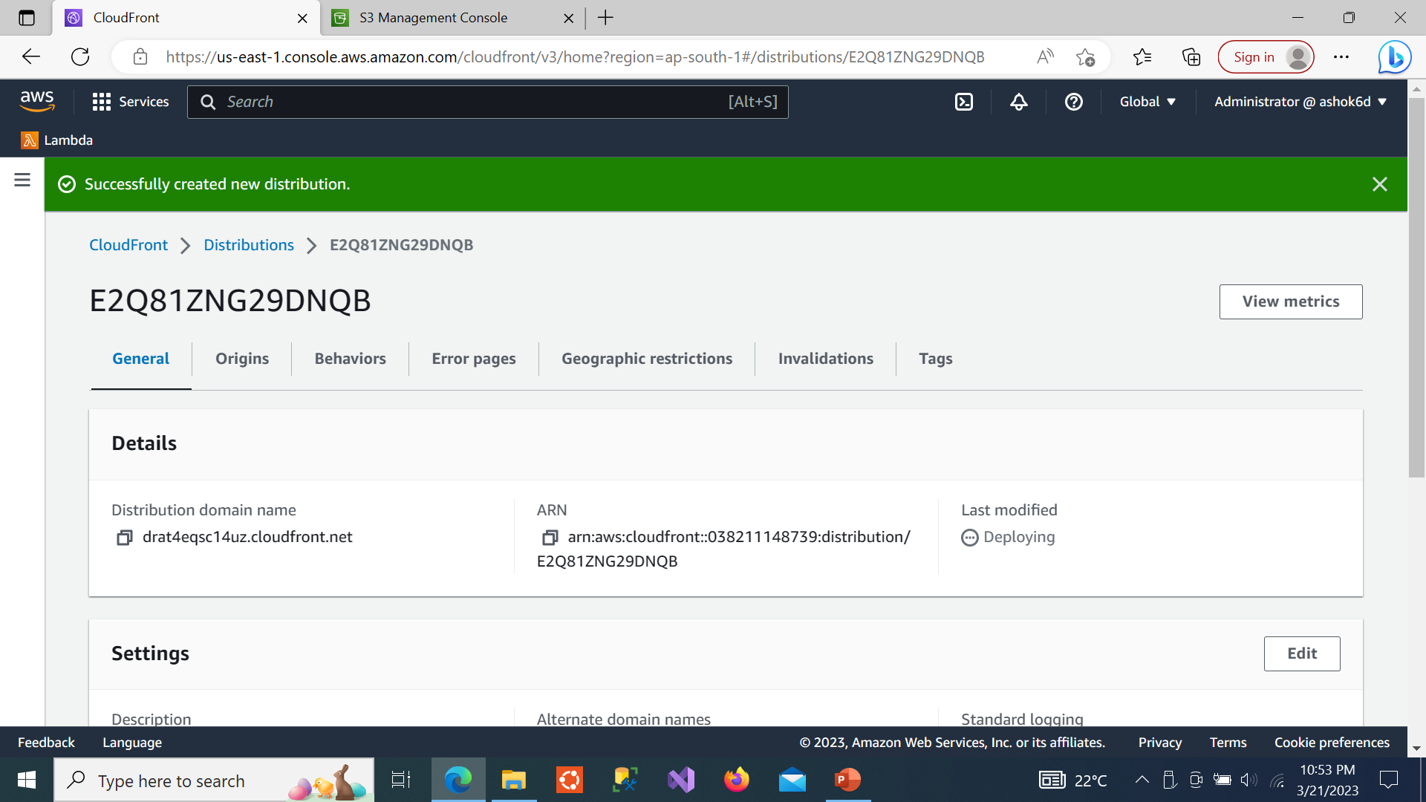
Successfully created new distribution ,copy the distributed domain name and paste in browser

Slide 40
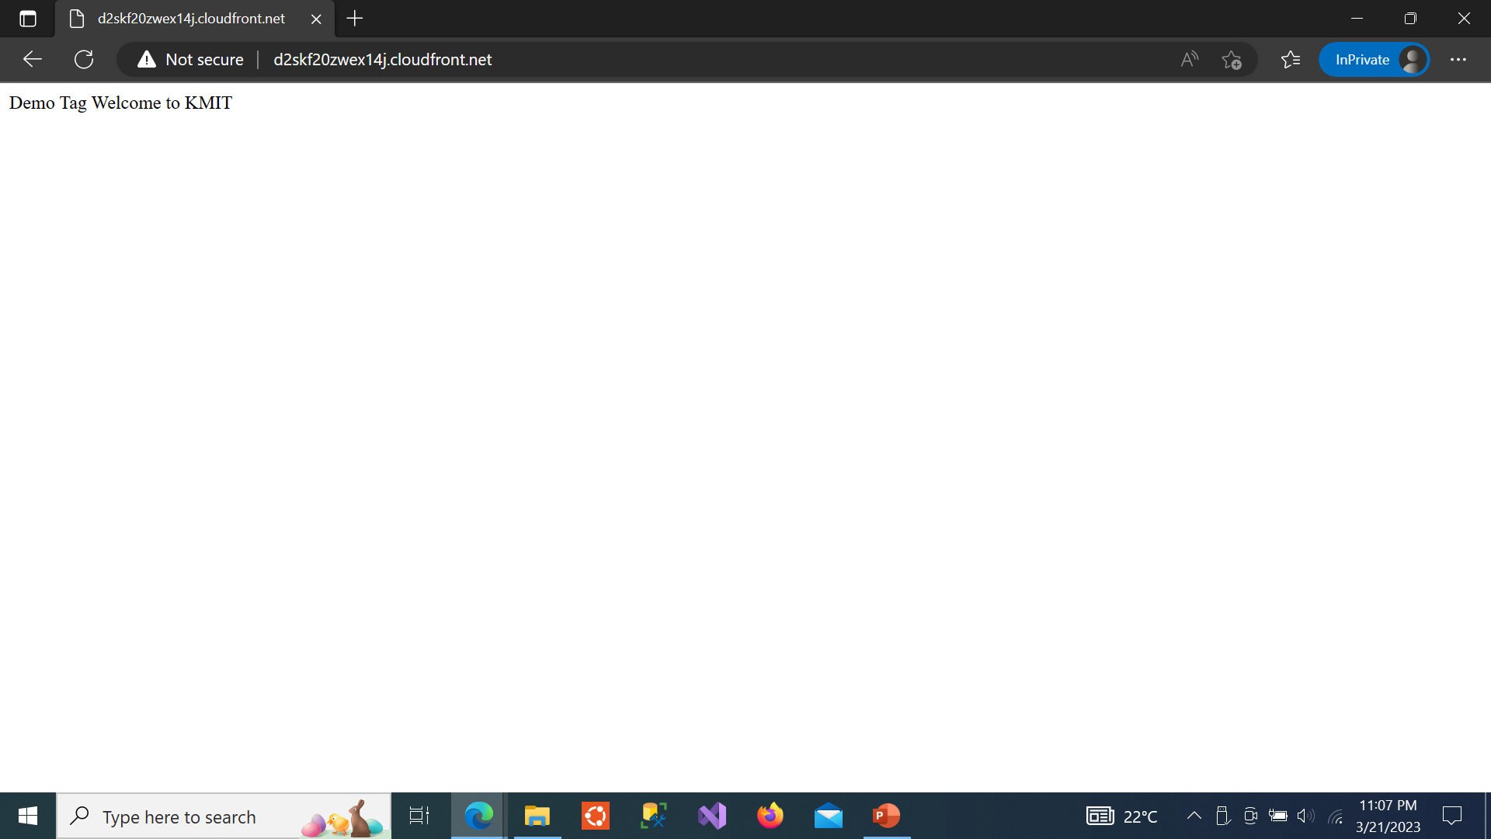
Simple Output (try to make it more interesting)

Slide 41
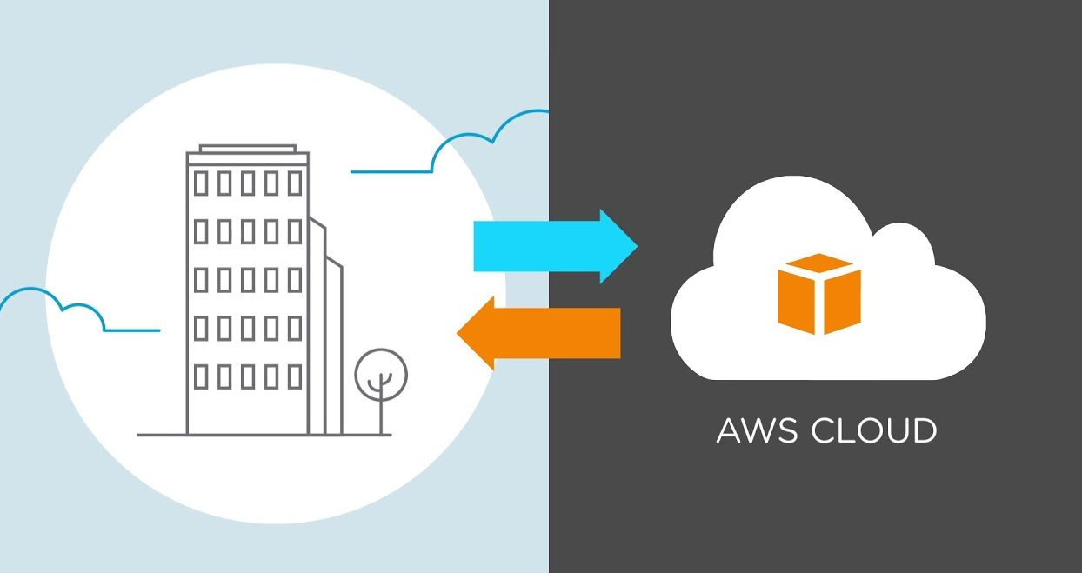
Migrating Application to Cloud
Cloud migration encompasses moving one or more enterprise applications and their IT environments from the traditional hosting type to the cloud environment, either public, private, or hybrid.
Cloud migration presents an opportunity to significantly reduce costs incurred on applications.
This activity comprises of different strategies like 6 R’s and phases like evaluation, migration strategy, prototyping, provisioning, and testing.

Slide 42
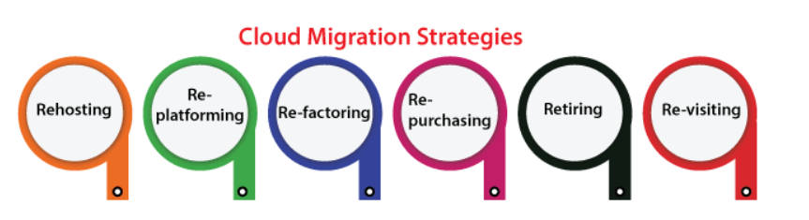
(a) Cloud Migration Strategies
The type of data and applications the enterprise transfers, and the location are shifted to, significantly impact the migration strategy designed and implemented. There are six main cloud migration strategies—rehosting (lift and shift), re-platforming, repurchasing, refactoring, retiring, and retaining(re-visiting).

Slide 43
1. Rehosting (lift-and-shift)
The most general path is rehosting (or lift-and-shift), which implements as it sounds.
It holds our application and then drops it into our new hosting platform without changing the architecture and code of the app.
Also, it is a general way for enterprises unfamiliar with cloud computing, who profit from the deployment speed without having to waste money or time on planning for enlargement.
Besides, by migrating our existing infrastructure, we are applying a cloud just like other data centers. It pays for making good use of various cloud services present for a few enterprises.
For example, adding scalable functions to our application to develop the experience for an improving segment of many users.

Slide 44
2. Re-platforming:
Replatforming is the second option. This is where we modify “lift and shift” into something more complicated but better suited to the new cloud environment.
Replatforming is a process that optimizes the application during the migration phase. This requires some programming knowledge and input.
You might move from your own database system to a managed DB hosted on a cloud provider.
In this type of migration, you stick with similar underlying technology but modify the business model and have cloud resilience as a huge bonus.
3. Re-factoring
It means to rebuild our applications from leverage to scratch cloud-native abilities because it could not perform serverless computing or auto-scaling.
A potential disadvantage is vendor lock-in as we are re-creating on the cloud infrastructure. It is the most expensive and time-consuming route as we may expect.
But, it is also future-proof for enterprises that wish to take benefit from more standard cloud features.

Slide 45
4. Re-purchasing:
Sometimes referred to as “drop and shop,” this cloud migration strategy comprises a full switch to another product. It means replacing our existing applications along with a new SaaS-based and cloud-native platform (such as a homegrown CRM using Salesforce).
The complexity is losing the existing training and code's familiarity with our team over a new platform. However, the profit is ignoring the cost of the development.
However, it may be one that does not have modern code or one that cannot be transported from one provider to the next. When transferring to a new product or using a proprietary platform, the “repurpose” strategy is used.

Slide 46
5. Retiring
When we don't find an application useful and then simply turn off these applications. The consequencing savings may boost our business situation for application migration if we are accessible for making the move.
6. Re-visiting
Re-visiting may be all or some of our applications must reside in the house. For example, applications that have unique sensitivity or handle internal processes to an enterprise. Don't be scared for revisiting cloud computing at any later date. We must migrate only what makes effects to the business.

Slide 47
(b) Process and Phases of Cloud Migration
There are various ways to go about a cloud migration based on the type of strategy you choose or the size of your organization.
1. Evaluation: Evaluation is carried out for all the components like current infrastructure and application architecture, environment in terms of compute, storage, monitoring, and management, SLAs, operational processes, financial considerations, risk, security, compliance, and licensing needs are identified to build a business case for moving to the cloud.
2. Migration strategy: Based on the evaluation, a migration strategy is drawn—a hot plug strategy is used where the applications and their data and interface dependencies are isolated and these applications can be operationalzed all at once. A fusion strategy is used where the applications can be partially migrated; but for a portion of it, there are dependencies based on existing licenses, specialized server requirements like mainframes, or extensive interconnections with other applications.

Slide 48
3. Prototyping: Migration activity is preceded by a prototyping activity to validate and ensure that a small portion of the applications are tested on the cloud environment with test data setup.
4. Provisioning: Premigration optimizations identified are implemented. Cloud servers are provisioned for all the identified environments, necessary platform softwares and applications are deployed, configurations are tuned to match the new environment sizing, and databases and files are replicated. All internal and external integration points are properly configured. Web services, batch jobs, and operation and management software are set up in the new environments.

Slide 49
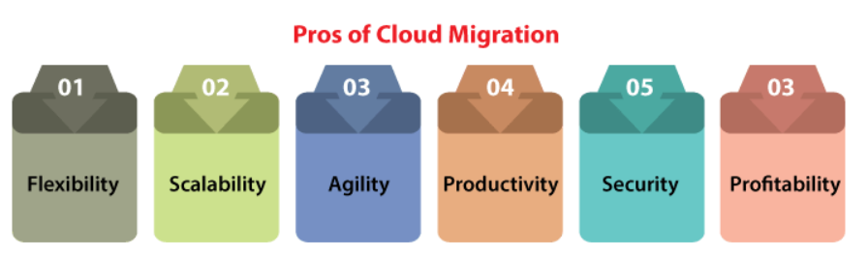
(3) Benefits of cloud migration
Flexibility: No organization facilitating experiences a similar demand level by a similar number of users every time. If our apps face fluctuations in traffic, then cloud infrastructure permits us to scale down and up to meet the demand. Hence, we can apply only those resources we require.
Scalability: The analytics grow as the organization grows with databases, and other escalates workloads. The cloud facilitates the ability to enhance existing infrastructure. Therefore, applications have space to raise without impacting work.

Slide 50
Agility: The part of the development is remaining elastic enough for responding to rapid modifications within the technology resources. Cloud adoption offers this by decreasing the time drastically it takes for procuring new storage and inventory.
Productivity: Our cloud provider could handle the complexities of our infrastructure so we can concentrate on productivity. Furthermore, the remote accessibility and simplicity of most of the cloud solutions define that our team can concentrate on what matters such as growing our business.
Security: The cloud facilitates security than various others data centers by centrally storing data. Also, most of the cloud providers give some built-in aspects including cross-enterprise visibility, periodic updates, and security analytics.
Profitability: The cloud pursues a pay-per-use technique. There is no requirement to pay for extra charges or to invest continually in training on, maintaining, making, and updating space for various physical servers.

Slide 51
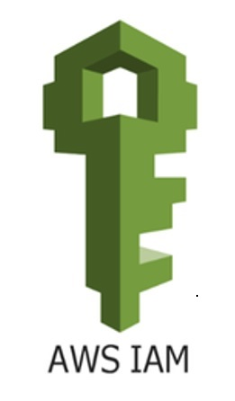
Managing Identity and Access (IAM)

Slide 52
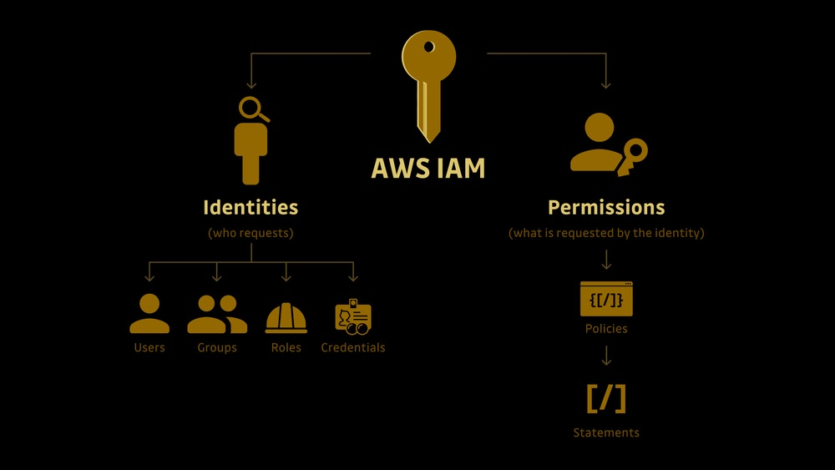
What is IAM?
AWS Identity and Access Management is a web service that enables AWS customers (organizations) to manage their users(employees) and user permissions in AWS Management Console.

Slide 53
Why IAM?
Without IAM, Organization with multiple users must either create multiple user accounts, each with its own billing and subscriptions to AWS products or share an account with a single security credential.
Without IAM, Organization don't have control about the tasks that the users can do.
With IAM, Organization can centrally manage users, security credentials such as access keys, and permissions that control which AWS resources users can access.
IAM enables the organization to create multiple users, each with its own security credentials, controlled and billed to a single aws account.
IAM allows the user to do only what they need to do as a part of the user's job.

Slide 54
AWS IAM Features
Centralized control : Root User can control creation and cancellation of each user's security credentials. Root user can also control what data in the aws system users can access and how they can access.
Shared Access : Users can share the resources for the collaborative projects.
Granular permissions: It is used to set a permission that user can use a particular service but not other services.
Free to use: AWS IAM is a feature of AWS account which is offered at no additional charge. You will be charged only when you access other AWS services by using IAM user.
Multifactor Authentication: An AWS provides multifactor authentication as we need to enter the username, password, and security check code to log in to the AWS Management Console.

Slide 55
Advantages of IAM
Centralized control of your AWS Account
Shared access to your AWS Account
Granular permissions
Identify federation ( users can login using LinkedIn , Facebook etc)
Multifactor Authentication ( password and OTP )
Setup password rotation policy ( eg: password will expire every 30 days )

Slide 56
Important Points
IAM is universal . It does not apply to regions at this time.
The “root account” is simply the account created when first setup your AWS account . It has complete Admin access.
New Users are assigned Access Key ID & Secret Access Keys when first created.
These are not same as a password and you cannot use the Access Key ID & Secret Access Key to join in to the console . You can use this to access Command line.
You can create and customize your own password rotation.

Slide 57
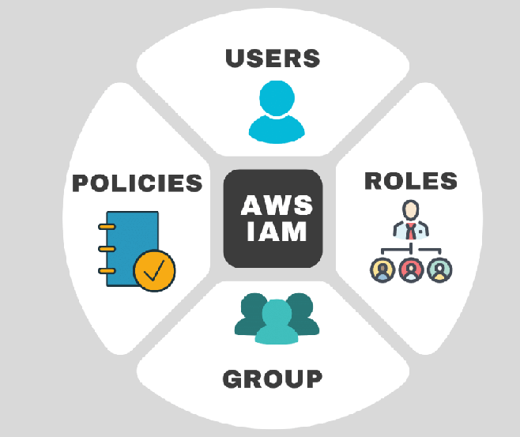
AWS Components
USERS- End Users ( people )
GROUPS– Collections of users, under one set of permissions.
ROLES – We can create roles and assign them to AWS resources
POLICIES– Set of permissions

Slide 58
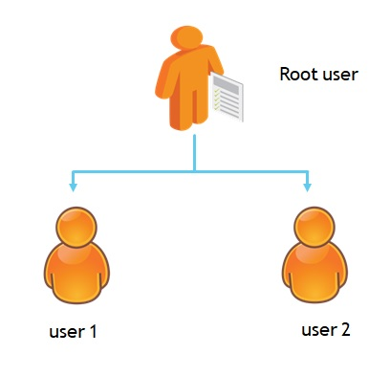
IAM USERS
IAM users are identities created by Root User with credentials and permissions attached.
The IAM user represents the person or service who uses the IAM user to interact with AWS
The IAM service lets you create a user name for every employee of your company so they can securely access AWS services
Root User can attach each IAM User to a group that has the permissions needed to perform particular tasks.
https://docs.aws.amazon.com/IAM/latest/UserGuide/reference_iam-quotas.html

Slide 59
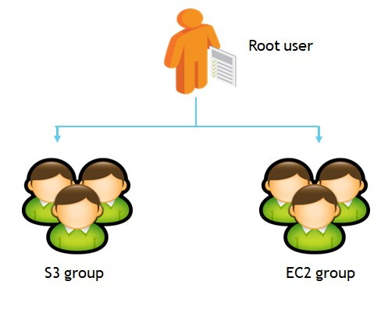
Group Users
IAM groups are collections of IAM users.
IAM groups help specify permissions across multiple users so that any permissions granted to the group will also be given to the individual users in the group.
Managing group Users is relatively easy.
Root User an create a group, add users to it, remove them from it, or change permissions in one place.

Slide 60
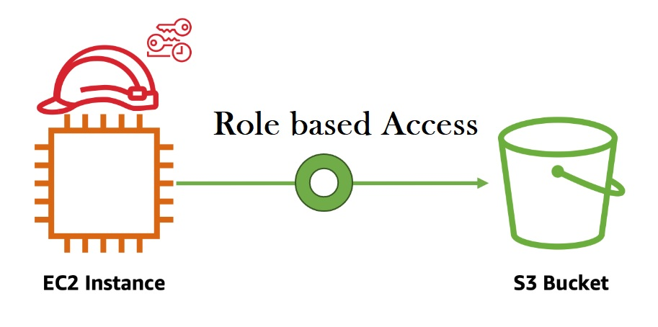
IAM ROLES
An IAM role is a set of permissions that define what actions are allowed and denied by an entity in the AWS console.
Role permissions are temporary credentials.

Slide 61
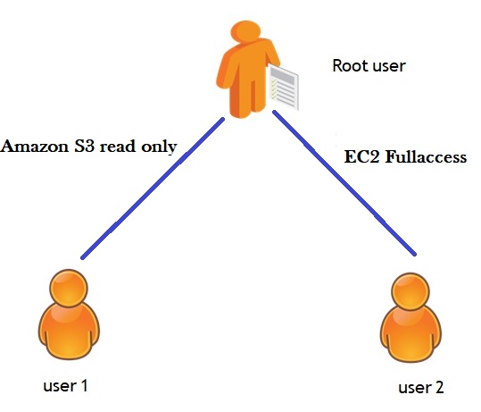
IAM Policies
A policy is an object in AWS that, when associated with an identity or resource, defines their permissions.
Root User manage access in AWS by creating policies and attaching them to IAM identities (users, groups of users, or roles) or AWS resources.
Permissions in the policies determine whether the request is allowed or denied.
Most policies are stored in AWS as JSON documents.

Slide 62
Use Case 1: Role Based Access Its related to administration. AWS Identity and Access Management (IAM) is a service that helps you securely control access to AWS resources. You use IAM to control who is authorized (has permissions) to use resources. When you first create an AWS account, it has complete access to all AWS services. This identity is called the AWS account root user.

Slide 63
(a) Procedure to Create IAM User Login to access S3 bucket as readonly mode from EC2 instance through GUI:
Step 1: Initially login with Root User to Create IAM Users
Step 2: Selecting IAM from AWS services
Step 3: Creating User group,enter user name
Step 4: Attach Policy search for –” administratoraccess” and click create user group
Step 5: Add Users (left side pane of Iam services)
Step 6: set user details
Step 7: Adding user to the group and download user credentials for further login
Step 8: Review & create User
Step 9:user created & added to the group
Step 10: Copy the Account ID of root user and log out

Slide 64
Step11: Login with IAM User paste the copied Account Id of root user
Step 12 :Enter the user credentials of I am user
Step 13:Launch EC2 Instance
Step 14: Connect EC2 instance
Step 15 :S3 bucket Access through GUI by updating Iam role by typing “aws s3 ls” in console ,it is
unable to access
Step 16: add Role to the user “go to Iam “ select user and select Rolesin the lefe panel of Iam services
Step 17: Click on create Role ,enter role name
Step 18: Adding Permissions: S3 read only
Step 19: Successfully S3 Role created with read-only permission
Step 20: EC2 s3 Role based Access is done
Step 21: Update EC2 Role from Actions ->Security->Modify Iam role-> select s3 role name->updated
Step 22: Showing S3 files in read only in Gui console

Slide 65
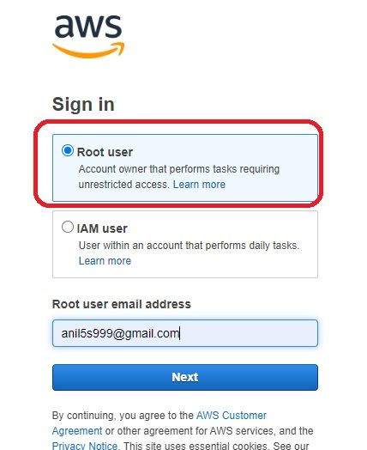
Step 1: Initially login with Root User to Create IAM Users

Slide 66
Procedure to Create IAM User Login to access S3 bucket as readonly mode from EC2 instance through CLI:
Step 1: Initially login with Root User to Create IAM Users
Step 2: Selecting IAM from AWS services
Step 3: Creating User group,enter user name
Step 4: Attach Policy search for –” administratoraccess” and click create user group
Step 5: Add Users (left side pane of Iam services)
Step 6: set user details
Step 7: Adding user to the group and download user credentials for further login
Step 8: Review & create User
Step 9:user created & added to the group
Step 10: click on the user it shows security credential tab -> click on access key
Step 11: Create access key via CLI and download .csv files with access key and secret key

Slide 67
Step 12: Copy the Account ID of root user and log out
Step13: Login with IAM User paste the copied Account Id of root user
Step 14 :Enter the user credentials of I am user
Step 15:Launch EC2 Instance
Step 16: Connect EC2 instance
Step 17 :S3 bucket Access through GUI by updating Iam role by typing “aws s3 ls” in console ,it is
unable to access
Step 18: now type the following command in console “aws configure”
Step 19: Enter access key, secret key downloaded when user created from security credential
Step 20: Enter default region : none, output format :none
Step 21: Now type “aws s3 ls” it shows access to S3 files in read only from CLI.

Slide 68
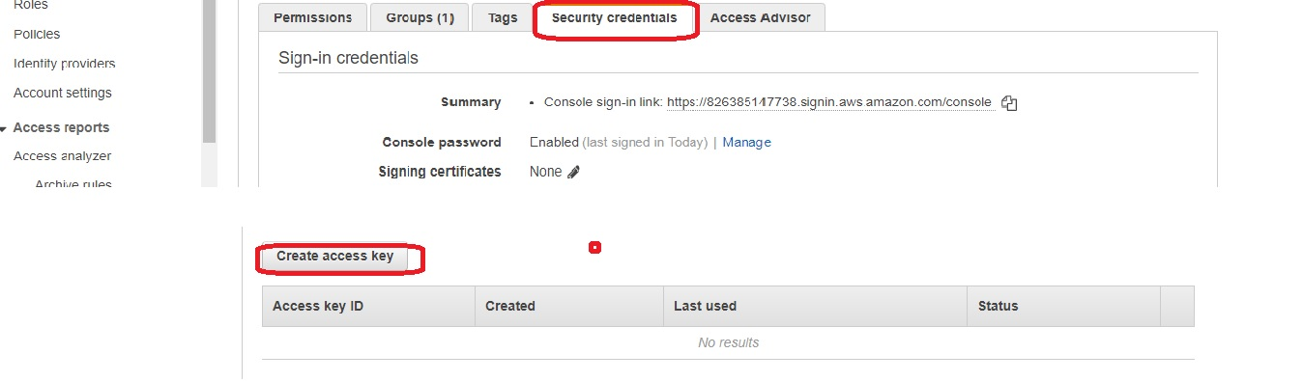
Step 10: Creating Access Key & Security Key
Select User---→Security credentials---→Create access key
Note : first 9 steps are same from previous procedure

Slide 69
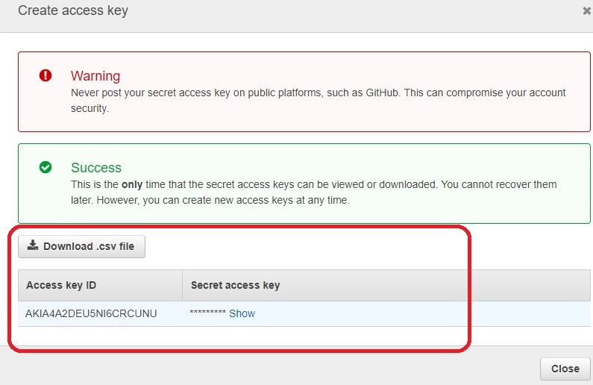
Step 11: Creating Access Key ID & Secret access Key

Slide 70
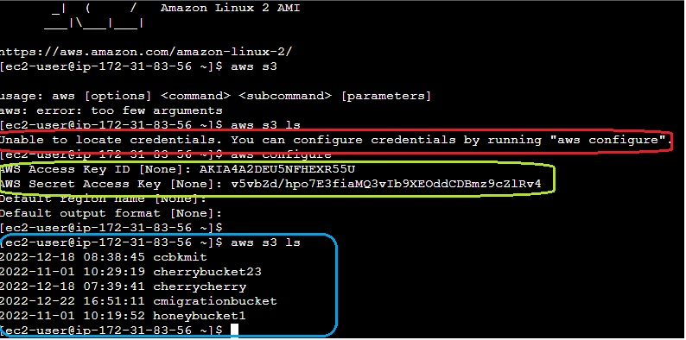
Step 21 :S3 bucket Access through Access Key ID & Secret Access Key ID

Slide 71
Use Case 2: Creating a User with S3readonly policy

Slide 72
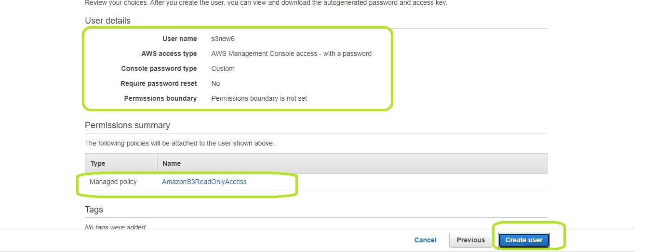
Use Case 2: Creating a User with S3readonly policy

Slide 73
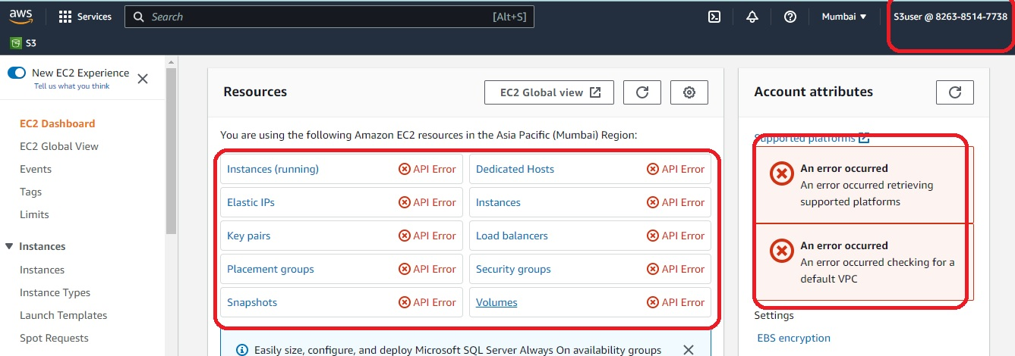
S3readonly user not able to create EC2 Instance

Slide 74
